Slide 1
Old Apps with new .NET features
Using modern C# language features and .NET packages in legacy projects
Kenny Pflug
Tech Lead at Synnotech

Slide 2

Kenny Pflug
Tech Lead at Synnotech
OSS: Light.GuardClauses, Light.Validation, Light.EmbeddedResources
Twitter: @feO2x
Code and slides are available at: https://github.com/feO2x/Adc2022NewFeaturesInOldDotnetProjects

Slide 3
Table of Contents
Understanding and manipulating csproj files
NuGet packages in old projects
Unlocking records, CallerMemberName, CallerArgumentExpression
Async await
Handling legacy projects
And everything in
.NET Framework 4!

Slide 4
Before we start: how to build .NET Framework 4 projects

Slide 5
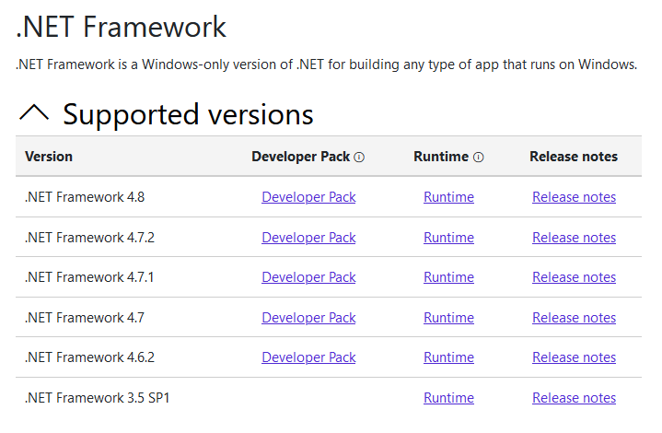
.NET Framework < 4.6.2 is no longer supported
The developer pack for .NET Framework 4.0 is no longer available and no longer supported by Microsoft
You need to have an old VS installation where this developer pack is installed and follow these instructions by Thomas Levesque
Fortunately, the developer pack for .NET 4 is available for download here
Copy the contents of the zip file to C:\Program Files (x86)\Reference Assemblies\Microsoft\Framework\.NETFramework\v4.0
Make sure to make a backup copy of your previous v4.0 folder

Slide 6
Understanding csproj files

Slide 7
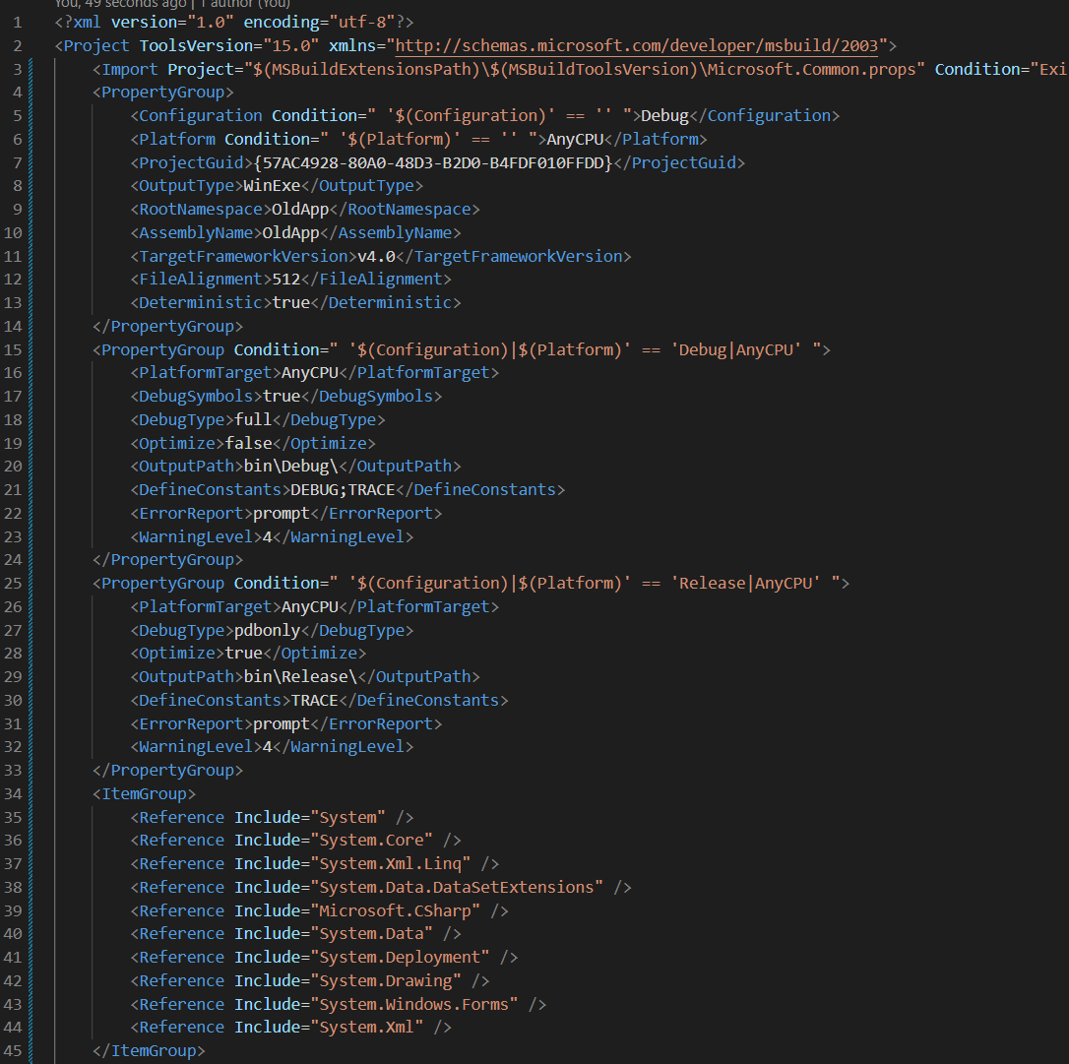
Property Groups and Item Groups
PropertyGroup: values are treated like in a key-value store
ItemGroup: values are treated like in a collection
Condition: a Boolean expression that enables or disables any element (values, groups, etc.)

Slide 8
Important values in csproj files (1)
Old csproj | New csproj (SDK style) | Remark
TargetFrameworkVersion | TargetFramework(s) | Specify the .NET version to build against, necessary in both versions
Configuration | Configuration | Determines if the compiler builds in debug or release mode. Not necessary in new csproj
OutputType | OutputType (default library) | Determines the type of the app (library DLL, console EXE, Windows EXE)
RootNamespace | RootNamespace | Determines the root namespace used for the project. Not necessary in new csproj
AssemblyName | AssemblyName | The name of the output DLL / EXE. Not necessary in new csproj

Slide 9
Important values in csproj files (2)
Old csproj | New csproj (SDK style) | Remark
PlatformTarget | PlatformTarget | Specifies the target architecture (x64, x86, AnyCPU)
Compile | Compile | Includes a file to processed by the CSC
EmbeddedResource | EmbeddedResource | Includes a file in the resulting DLL/EXE as an embedded resource
Import | Import | Imports other files containing msbuild props and targets

Slide 10
Important values in csproj files (3)
Old csproj | New csproj (SDK style) | Remark
Reference | Reference | References a DLL/EXE in this project. Non-BCL references need a location hint. Also used for referencing NuGet package DLLs when using packages.config
PackageReference | PackageReference | References a DLL from a NuGet package (new way instead of packages.config)
- | FrameworkReference | Includes a DLL / several DLLs that are distributed with .NET Core / .NET 6, e.g. Microsoft.AspNetCore.App

Slide 11
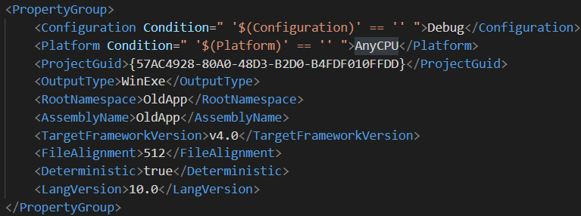
Setting the C# version
Setting LangVersion to a valid C# version allows you to use many new language features that don’t require additional NuGet packages
Beware that your VS / MSBuild version must support your target C# version
VS 2022 -> C# 10.0
VS 2019 -> C# 9.0

Slide 12
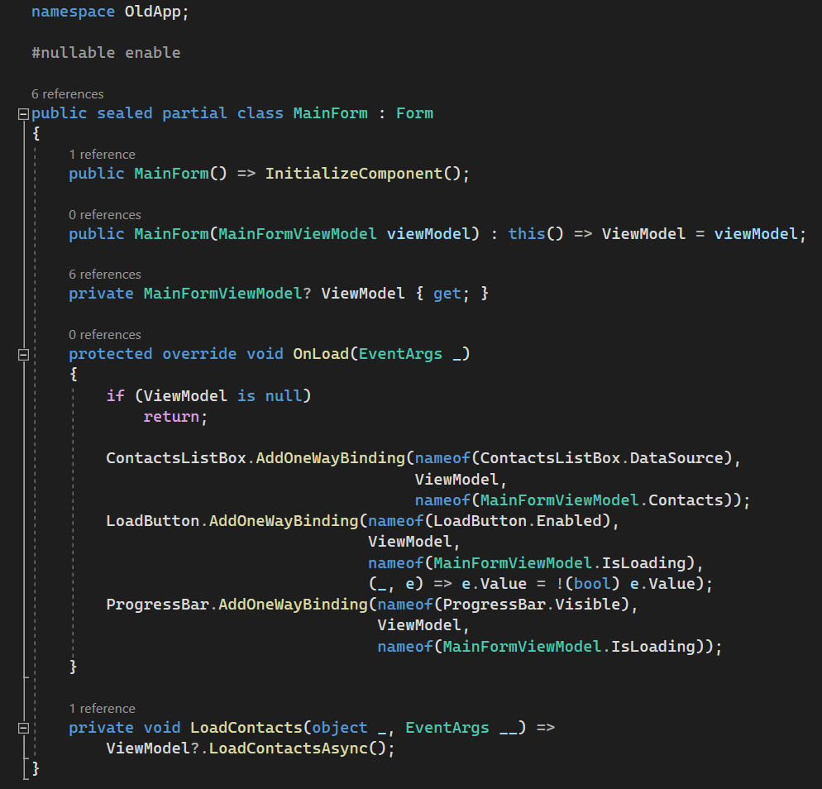
Upgrading to C# 10 enables you to use
Interpolated strings
Pattern Matching
Switch expressions
Null-Conditional Operator
File-Scoped Namespaces
Get-only Properties
Target-Typed New
Expression bodies
Local Functions
Top Level Statements
And many more

Slide 13
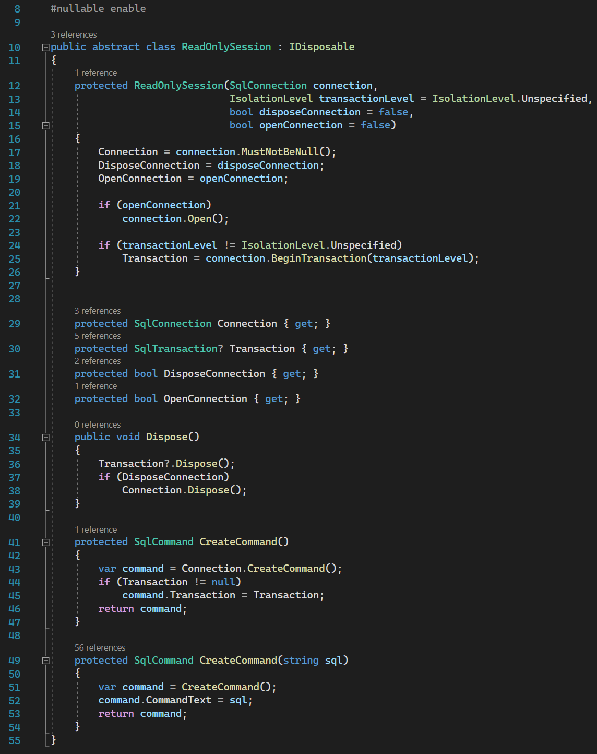
Nullable Reference Types
Setting <Nullable>enable</Nullable in old-style csproj files does not work
You need to use the #nullable enable precompiler directive in every file where you want to use NRTs

Slide 14
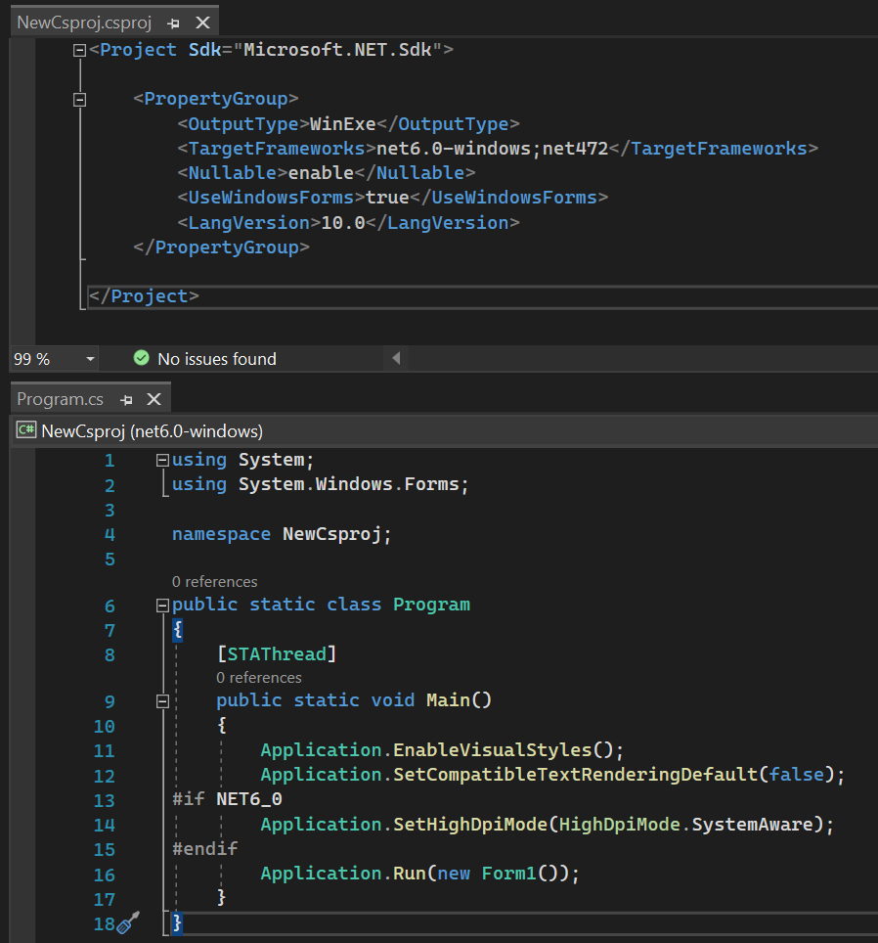
Consider moving to the new csproj format

Slide 15
NuGet Packages

Slide 16
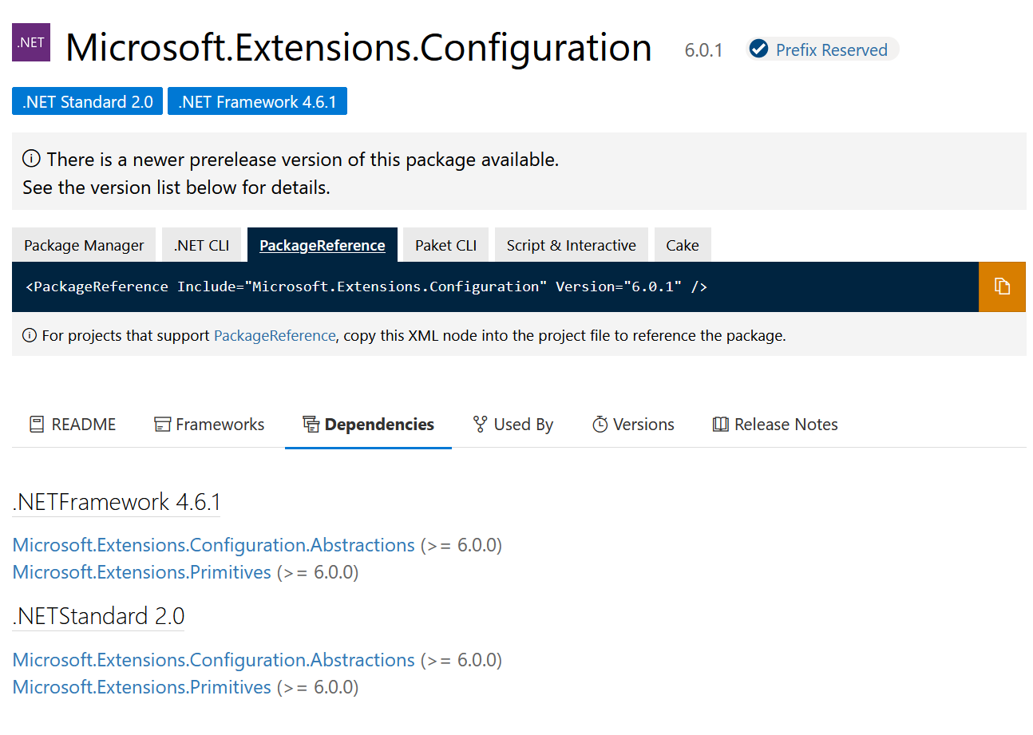
Referencing NuGet packages is no fun
Most NuGet packages do not support .NET Framework less than 4.6.1
Frameworks/libraries that can be included as source are great: LightInject, Light.GuardClauses, Light.EmbeddedResources

Slide 17
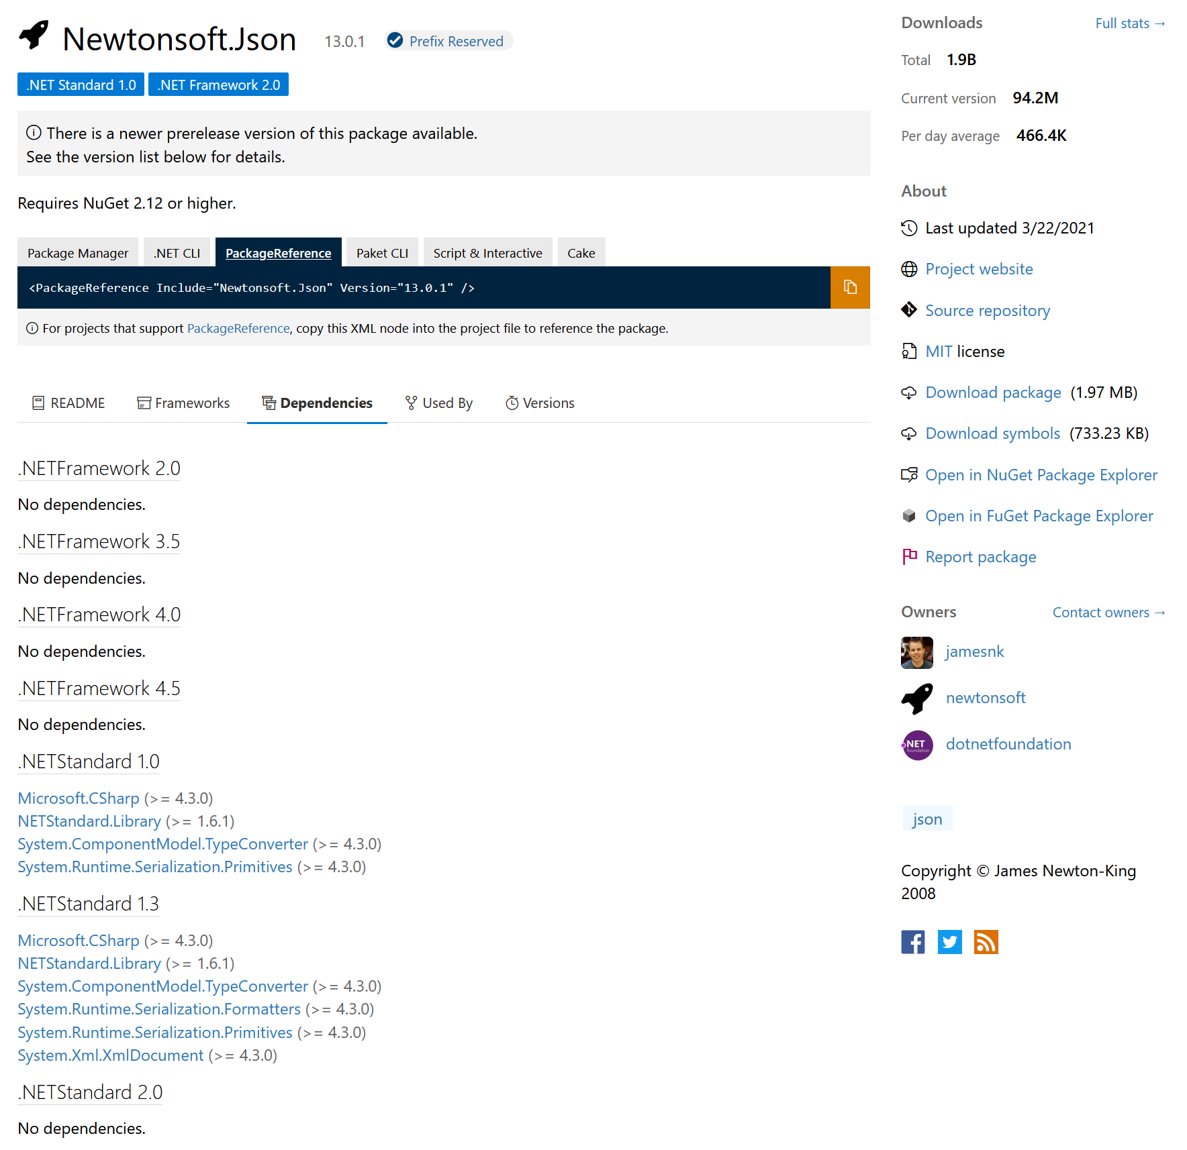
The good packages

Slide 18
Consider moving from packages.config to PackageReference
PackageReference is easier to handle, especially because of
Transitive dependency management
Automatic binding redirects
App
Data Access
Linq2Db
Synnotech.Migrations
Core
Light.Validation

Slide 19
Unlocking more C# features

Slide 20
Records and init
Simply paste the code below into your code base and you can use init in properties and record classes and record structs
Also, the with keyword works with records
using System.Diagnostics;
using System.Diagnostics.CodeAnalysis;
namespace System.Runtime.CompilerServices;
/// <summary>
/// Reserved to be used by the compiler for tracking metadata.
/// This class should not be used by developers in source code.
/// </summary>
[ExcludeFromCodeCoverage]
[DebuggerNonUserCode]
internal static class IsExternalInit { }

Slide 21
CallerMemberName
Allows you to shorten calls that require the name of the calling member
Mostly used with INotifyPropertyChanged implementations
using System;
namespace System.Runtime.CompilerServices;
[AttributeUsage(AttributeTargets.Parameter, AllowMultiple = false, Inherited = false)]
internal sealed class CallerMemberNameAttribute : Attribute { }

Slide 22
CallerArgumentExpression
Same thing – paste the code below into your project to use the CallerArgumentExpressionAttribute
namespace System.Runtime.CompilerServices;
[AttributeUsage(AttributeTargets.Parameter, AllowMultiple = false, Inherited = false)]
internal sealed class CallerArgumentExpressionAttribute : Attribute
{
public CallerArgumentExpressionAttribute(string parameterName)
{
ParameterName = parameterName;
}
public string ParameterName { get; }
}

Slide 23
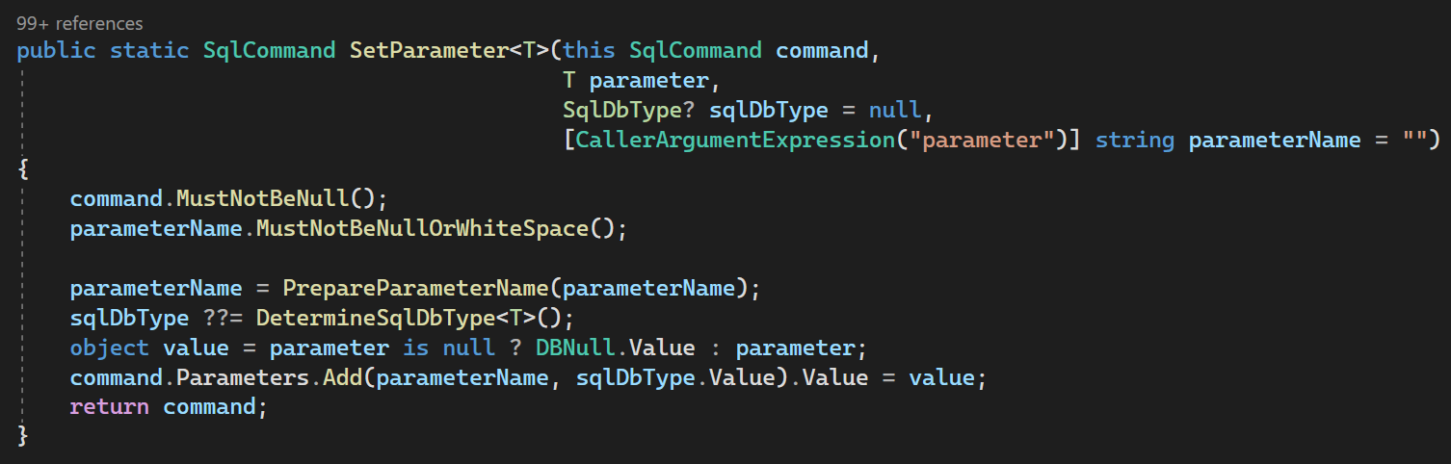
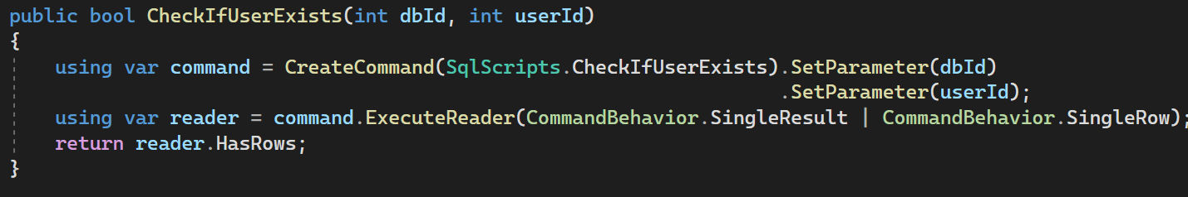
How to use CallerArgumentExpression

Slide 24
Async Await in .NET Framework 4

Slide 25
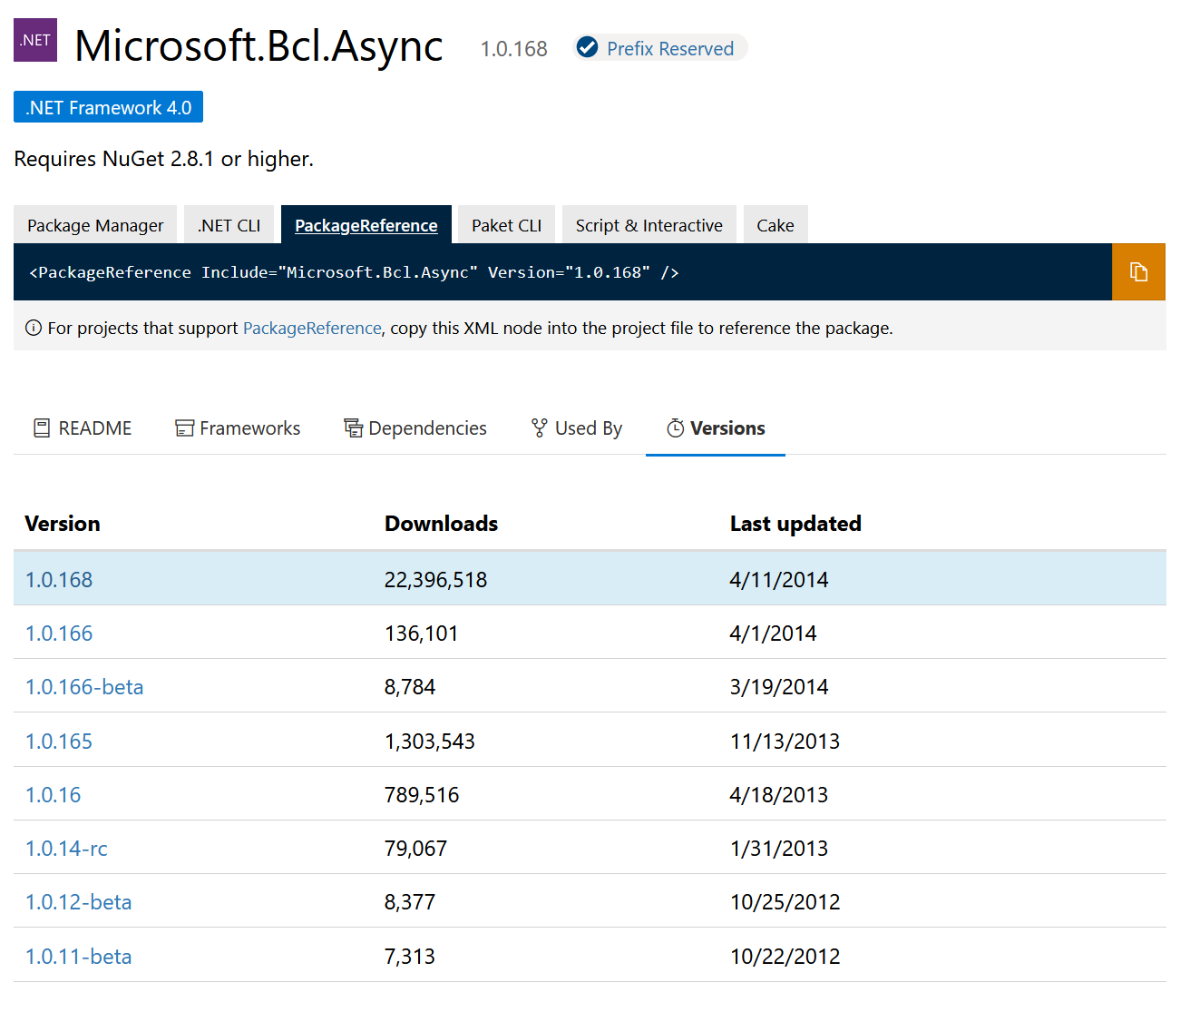
Adding Async-Await Support in .NET Framework 4
Add Microsoft.Bcl.Async to your project to add support for async await
This helps with async compute, but most APIs for async I/O will not be there (for example on streams, data access, HTTP clients, etc.)
However, you can use Task.Factory.FromAsync to encapsulate BeginXXX and EndXXX methods (the old way of doing asynchronous programming in .NET) in a Task and await it

Slide 26

Live Demo
A simple .NET Framework 4 app with modern features

Slide 27
Handling Legacy Projects

Slide 28

I Hate Spaghetti Code
No layering makes code files long and untestable - assembling SQL statements in button handlers (ノ_<。)
Properties capture random state that methods with hundreds, maybe thousands of lines of code rely on
Code has dependencies to Singleton forms – it’s hard to shield from the rest of the app
Features cannot run independently from the rest of the app, for example in unit tests
Badly formatted code that’s hard to read

Slide 29
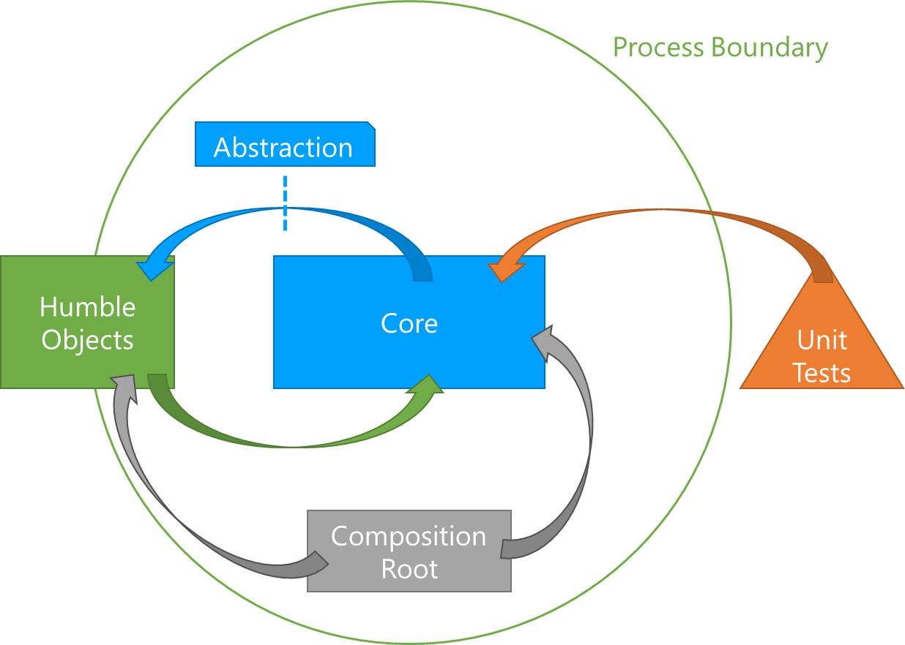
Don’t write new features in the old style
Decouple I/O from your core logic to make the latter automatically testable
I/O should be done via humble objects that can be exchanged in tests by mocks
Have a dedicated composition root where you assemble the components of your design
Don’t hardwire important values, make them configurable
Create yourself Islands of Joy in the entangled mess

Slide 30
A last word on installers
Write the simplest installers that are possible
Many installer technologies do not allow you to debug (I’m looking at you, WiX Toolset and Nullsoft Installer)
If you need to perform complex logic during installation (for example installing several apps/frameworks), consider implementing a desktop app that can be debugged and automatically tested

Slide 31


And a final word on migrating from .NET Framework to .NET 6
.NET 6 offers the newest features, way better performance, and cross-platform capabilities
However, you tie into the new release cycle
You need to stay on top of major updates, LTS-releases are only supported for about 3.5 years, release in between only for 1.5 years
According to Microsoft, .NET Framework will be supported with security patches as long as Windows exists, but expect no major new features

Slide 32
Thanks for your attention
Questions?

